Slide 1
WALHALLA HIGH SCHOOL SIC
Presenters:
Principal, Steve Garrett
Co-Chair, Lorilei Swanson
Parent, Olivia Timms
Student, Cooper Timms
Notes:
NOTE:
To change the image on this slide, select the picture and delete it. Then click the Pictures icon in the placeholder to insert your own image.

Slide 2
WALHALLA HIGH SCHOOL SIC
2018 Riley Award Presenters:
Principal: Steve Garrett
Co-Chairs: Lorilei Swanson and Jessica Duke
Parents: Tricia Burgess and Olivia Timms
Students: Cooper Timms, Elliot Wechter, Brij Patel, Madison MacLachlan and Rachel Twitty
Notes:
NOTE:
To change the image on this slide, select the picture and delete it. Then click the Pictures icon in the placeholder to insert your own image.

Slide 3
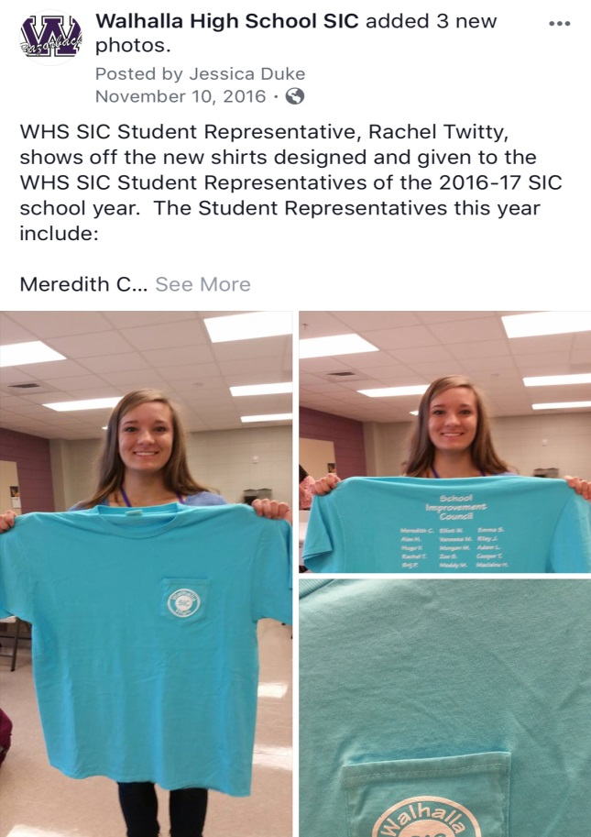
INCREASE STUDENT SIC PARTICIPATION
Changed Meetings to 7:15am to not conflict with after school activities
Identified a teacher advisor to hold regular meetings with students and have student SIC sponsored events
Created time on the SIC meeting agenda for student reports/feedback
Student SIC t-shirts designed by the students and provided by the school

Slide 4
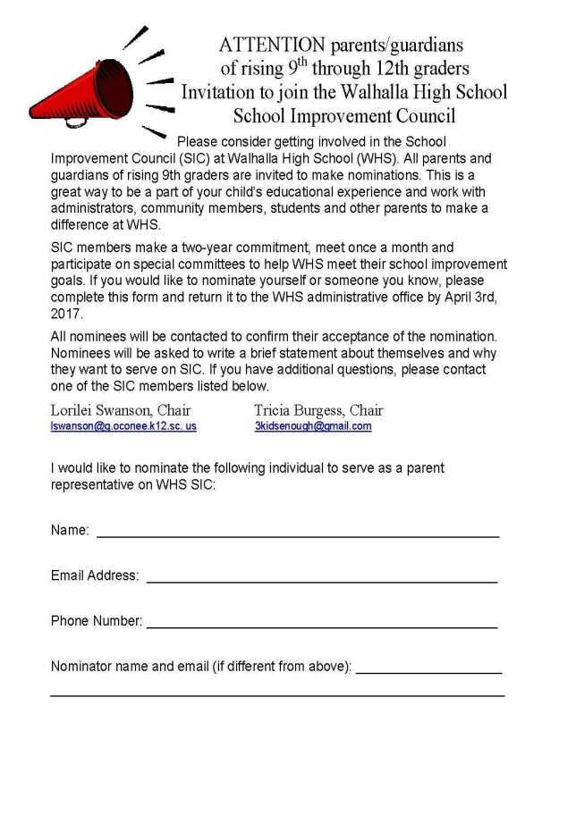
INTEGRATION OF TAMASSEE-SALEM HIGH SCHOOL (TSHS) SIC WITH WHS SIC
Actively recruited TSHS students, teachers and parents to serve on the WHS SIC
TSHS Chair became Co-Chair of WHS SIC
Invited all TSHS parents to automatically serve on the WHS SIC, if desired

Slide 5
SIC DATA COLLECTION
WHS SIC Parent Survey Questions | Satisfaction Percentage
My child has formed caring and supportive relationships with teachers and staff at WHS. | 95.8
I am informed about opportunities for parents to be meaningfully involved at WHS. | 84.4
WHS is a welcoming and inviting place for parents. | 94.1
WHS provides meaningful and engaging learning experiences to help my child be successful in the area of his or her choice. | 95
Developed a survey to assess the degree of satisfaction with school climate, communication, student learning, parent engagement, and student engagement
Informally surveyed students
Invited Dr. Myriam Torres to conduct a focus group with Latino families

Slide 6
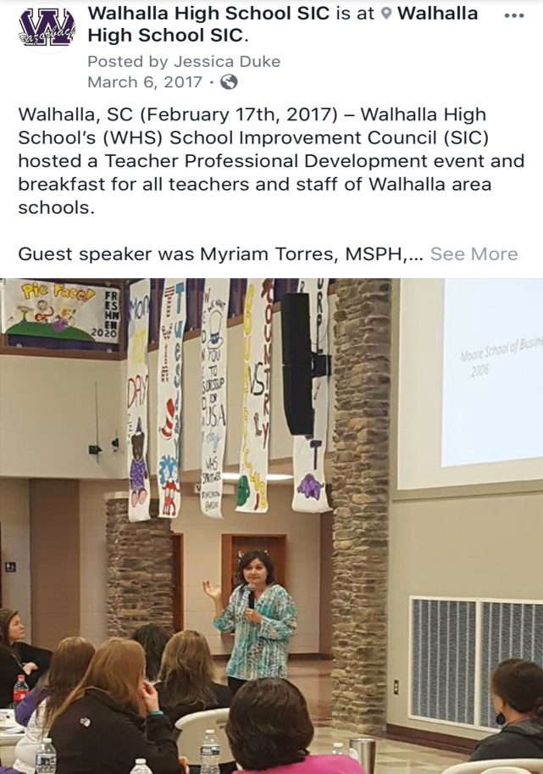
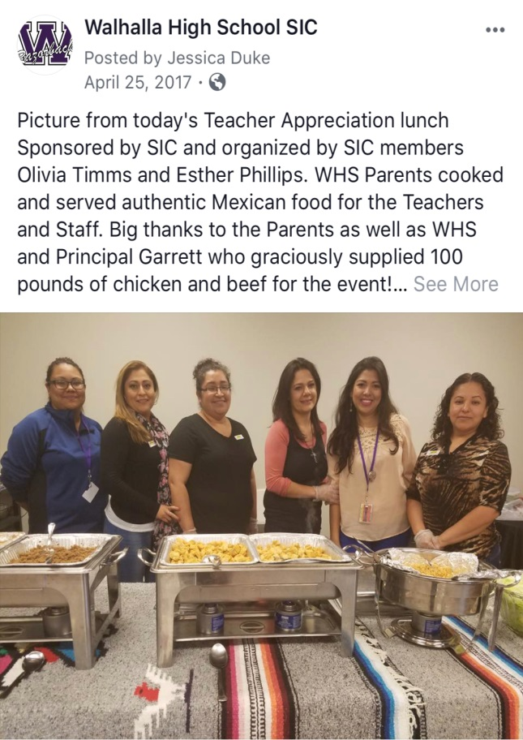
COMMUNICATION AND OUTREACH TO ENGLISH AND NON-ENGLISH SPEAKING PARENTS
Created SIC social media sites, including Facebook, Instagram, and Twitter and posted in English and Spanish
Hosted family-focus event featuring nationally known speaker Kathy Whitmire presenting on “How the Teenage Brain Works”
Recruited parents to help sell tickets at spring sporting events
Hosted a Walhalla United professional development for all five schools in the Walhalla area to hear Dr. Myriam Torres present on “Engaging Latino Families in Schools”
Invited our Latino focus group to host our annual Teacher Appreciation Luncheon

Slide 7
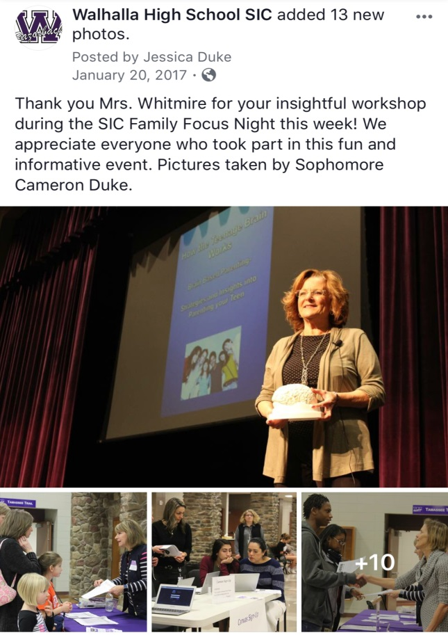
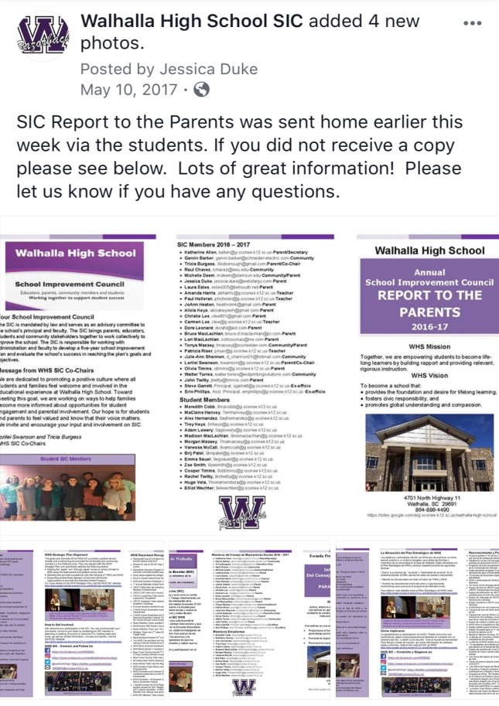
COMMUNICATION AND OUTREACH TO ENGLISH AND NON-ENGLISH SPEAKING PARENTS CONT…

Slide 8
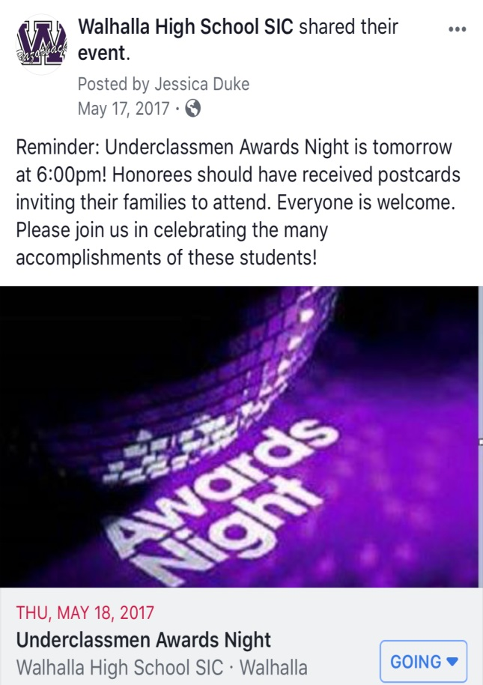
INCREASING OPPORTUNITIES FOR STUDENT SUCCESS AND RECOGNITION
Hosted first annual Underclassman Awards Night
Supported SIC community member founded in-school free boutique called Grace’s Closet
Facilitated a mentoring program with Southern Wesleyan University to mentor Latino athletes and at-risk students
Recognized student Razor of the Month and Nurturing Oconee’s Workforce recipients at our monthly SIC meetings

Slide 9
THANK YOU!!
WHS SIC:
2018 Dick and Tunky Riley Award
for
SIC Excellence Winner
Notes:
NOTE:
To change the image on this slide, select the picture and delete it. Then click the Pictures icon in the placeholder to insert your own image.

